Slide 1
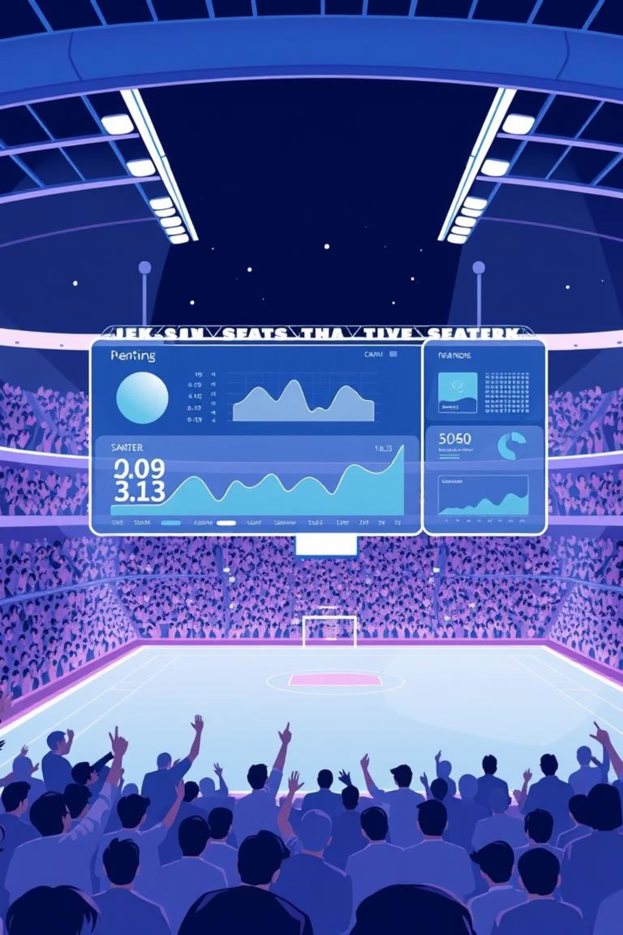
🏟️ Sports Dashboard Project
Competitions & Complexes Visualization using Streamlit and MySQL

Slide 2
📌 Project Overview
Interactive Dashboard
Data Integration
Developed a dynamic dashboard utilizing Streamlit for real-time data exploration.
Integrated competition and complex data from MySQL (CSV), ensuring robust data handling.
Key Visualizations
Dynamic Filtering
Visualized competition types, gender distribution, and venues per complex for clear insights.
Implemented interactive filters for users to explore specific data subsets instantly.

Slide 3





🛠️ Tools & Technologies
Python 3.10+
Streamlit
Data Libraries
The core programming language for backend logic and data processing.
Used for rapid development and deployment of the interactive web application.
Pandas, Seaborn, and Matplotlib for efficient data manipulation and compelling visualizations.
MySQL
GitHub
Utilized for persistent storage and management of the competitions and complexes datasets.
For collaborative version control, code hosting, and project management.

Slide 4
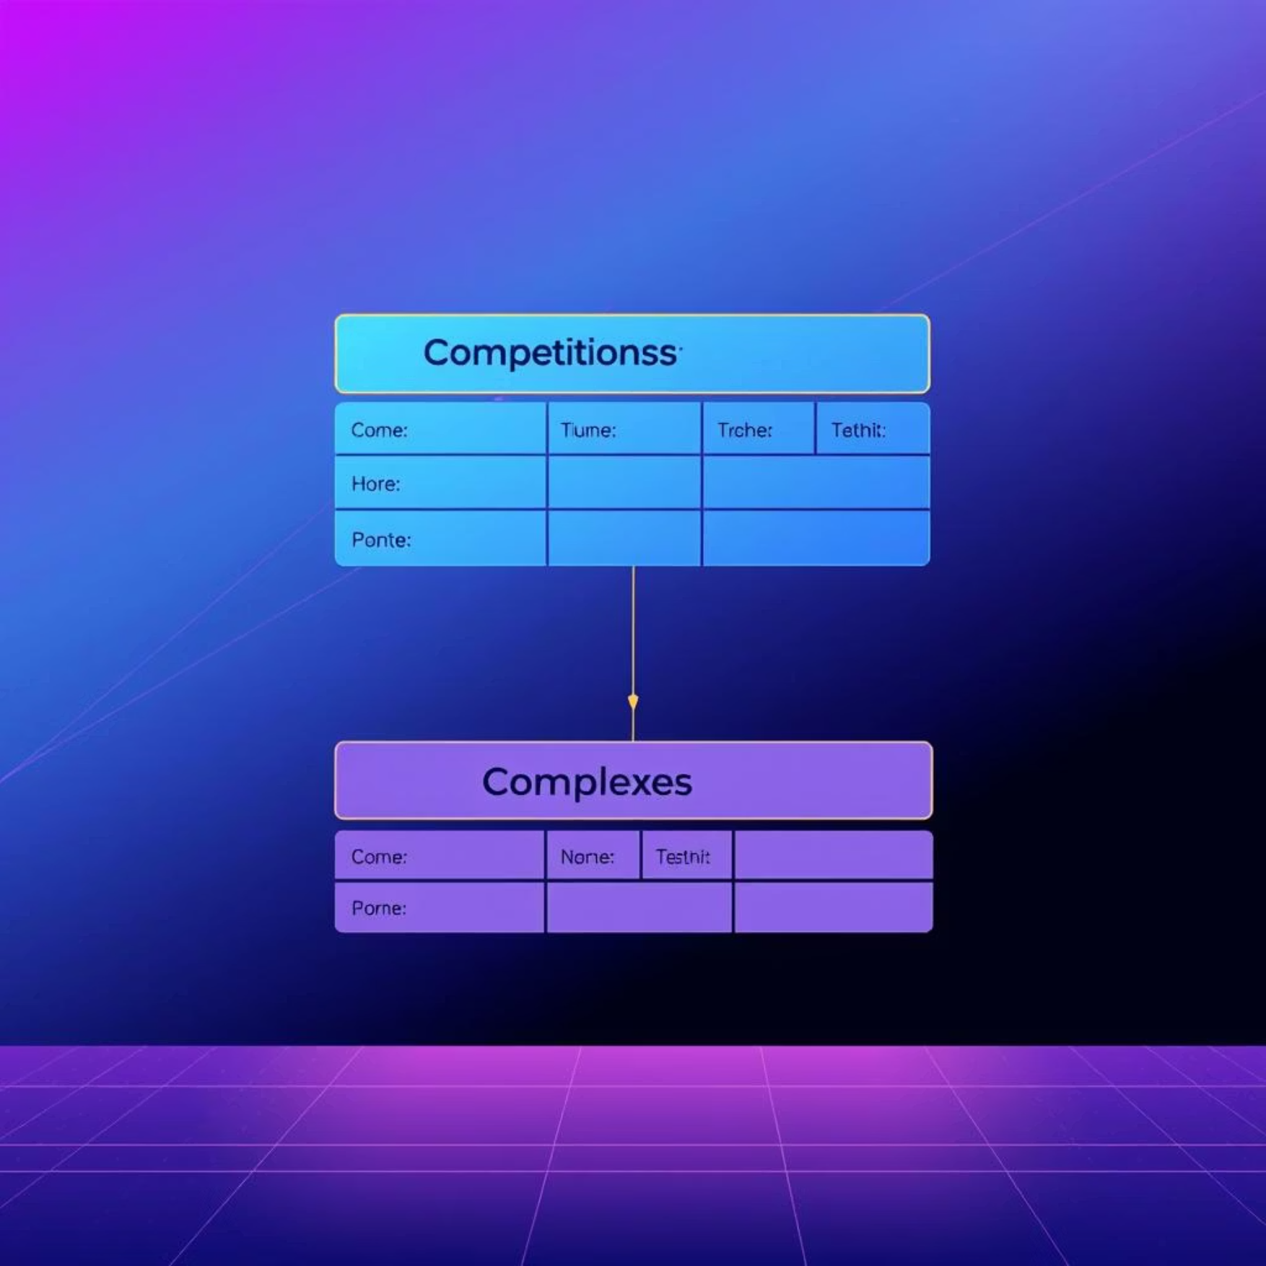
📊 Data Description
Competitions Dataset
Complexes Dataset
Contains detailed information about various sports competitions.
Provides data on sports complexes and their associated venues.
id: Unique identifier for each competition.
id: Unique identifier for each complex.
name: Name of the competition.
complex_name: Name of the sports complex.
type: Category of the competition (e.g., league, tournament).
venues: Normalized list of venues within the complex.
gender: Gender of participants (e.g., male, female, mixed).
timezone: Timezone of the complex's location.
category: Broader classification of the competition.
country: Country where the complex is located.
parent_id: Links to a parent competition if applicable.

Slide 5
✨ Dashboard Features
Competition Filters
Venue Filters
Data Tables
Filter competitions by type (e.g., league, cup) and gender (male, female, mixed).
Efficiently filter venues by specific complex names to narrow down locations.
Display raw competition and venue data in interactive, sortable tables.
Visualizations
Interactive Design
Insightful bar, pie, and count plots for category distribution.
A responsive and user-friendly interface for seamless data exploration.

Slide 6
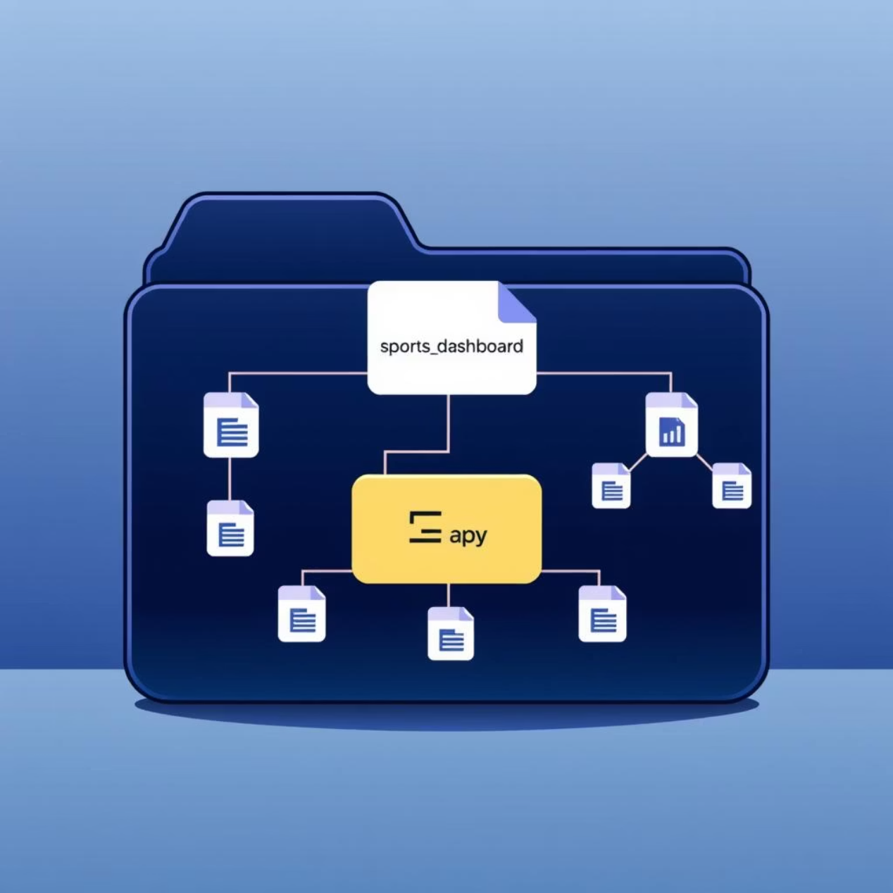
📁 Folder Structure
sports_dashboard/├── app.py├── requirements.txt├── README.md├── SQL Data for Competitions table Answers.csv└── SQL Data for Complexes table Answers.csv
This structured layout ensures easy navigation and organization of project files, separating application logic, dependencies, documentation, and data sources for clarity and maintainability.

Slide 7
🚀 How to Run the Project
2. Install Dependencies
1. Clone the Repository
Navigate to the project directory in your terminal and run pip install -r requirements.txt to install all necessary Python libraries.
Obtain the project files by cloning the GitHub repository or extracting the provided ZIP archive to your local machine.
4. Access the Dashboard
3. Run the Streamlit App
Open your web browser and navigate to http://localhost:8501 to view and interact with the live dashboard.
Execute the command streamlit run app.py from the project directory to launch the dashboard.

Slide 8

✅ Conclusion
The Sports Dashboard Project demonstrates a successful application of modern data visualization and web development tools. This dashboard provides valuable insights into sports competitions and complexes, built on real-world data.
Successfully developed an interactive sports dashboard leveraging Streamlit.
Utilized realistic competition and venue data for comprehensive analysis.
Streamlit facilitated rapid development of user-friendly visualizations.
The project is ready for deployment or extension with real-time API integrations.

